Slide 1

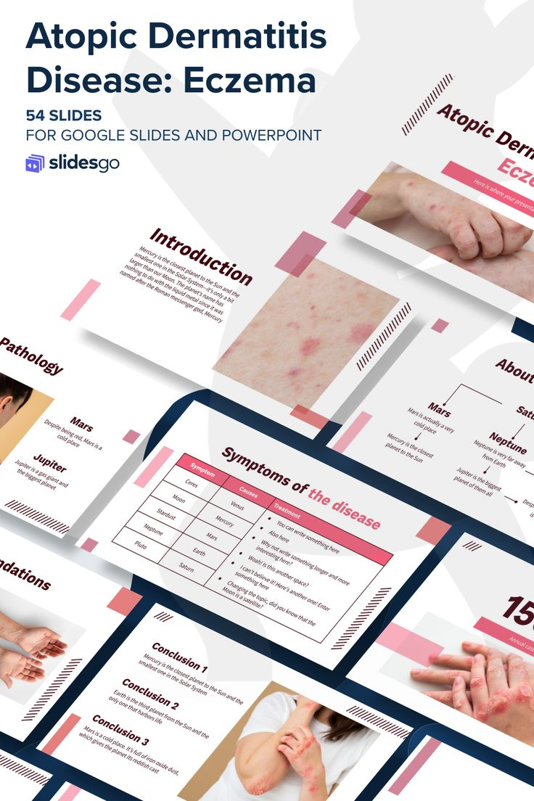

DermaScope AI An AI-Driven Ecosystem for Autonomous Skin Disease Diagnosis and Proactive Management
24-25J-210

Slide 2




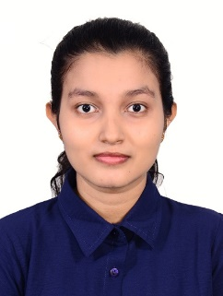



Mr. Samadhi Rathnayake
Supervisor
Gimmana M.R.M IT21176456
Dr. Junius Anjana
Co - Supervisor
Lakshani D.M.W.S
IT21262104
Dr. Saman Gunasekara
External Supervisor
Dr. kasun Nayanakantha
External Supervisor
Perera W.A.S.K
IT21261732
Project ID: 24-25J-210

Slide 3

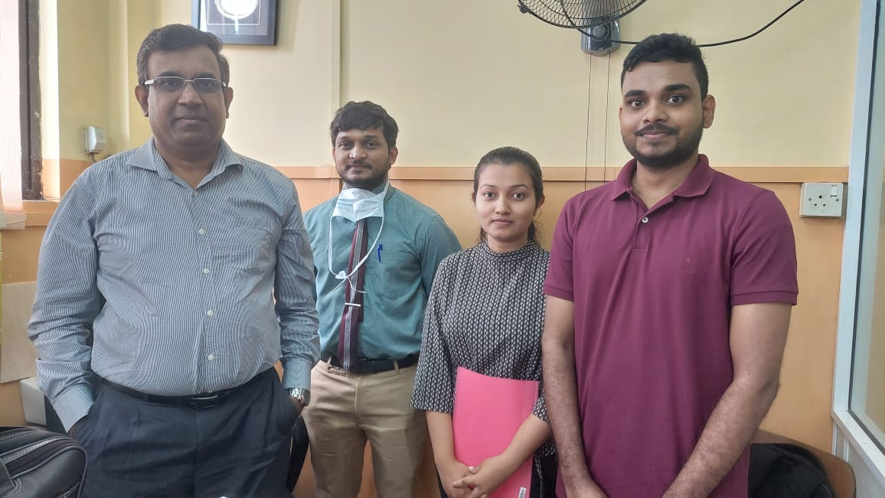

Dr. Saman Gunasekara
External Supervisor
MBBS. MD. (Dermatology)
Consultant Dermatologist
Teaching Hospital - Kalubowila
Dr. kasun Nayanakantha
External Supervisor
Dermatologist
Project ID: 24-25J-210

Slide 4
Introduction
Skin Diseases
Skin diseases are conditions that affect your skin.
They may cause rashes, inflammation, itchiness or other skin changes.
Some skin conditions may be genetic, while lifestyle factors may cause others.
Project ID: 24-25J-210

Slide 5
Importance of Giving Attention to Skin Diseases
Impact on Physical Health
Discomfort and pain
Infection risk
Impact on Mental Health
Low self-esteem
Depression and anxiety
Isolation
Economic Impact
Healthcare costs
Lost productivity
Project ID: 24-25J-210

Slide 6
Research Question
How to leverage machine and deep learning for enhanced dermatological care?
Up to what extent machine and deep learning can be used in Dermatology?
How trustworthy and useful are the built models?
How transparent is this technology?
Project ID: 24-25J-210

Slide 7

Answer!
Introduce optimized methods and algorithms to efficiently analyze
skin diseases while align with dermatological theories and laws.
Trustworthiness and transparency of the technology used.
Project ID: 24-25J-210

Slide 8
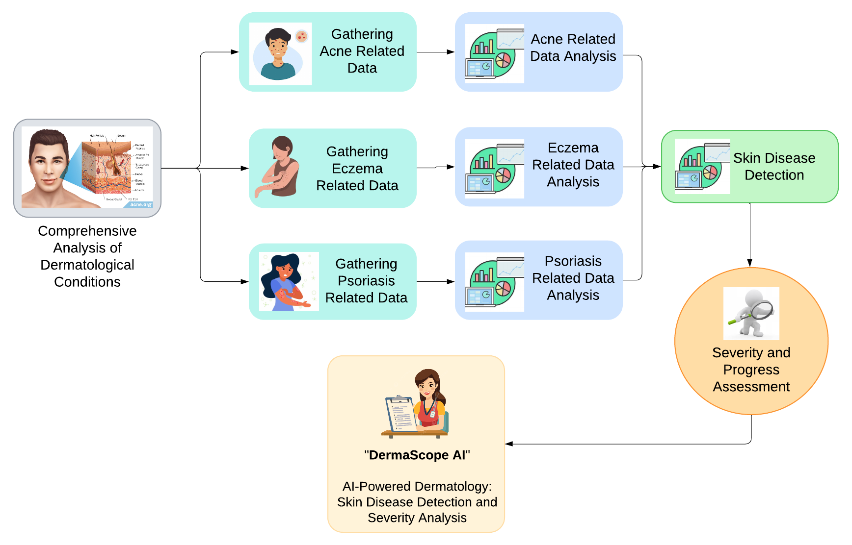
System Diagram

Slide 9

5
Research Objectives
4
Develop a System for Real-Time Monitoring and Management of Skin Diseases Using AI and Machine Learning Techniques.
3
2
1
Project ID: 24-25J-210

Slide 10

5
Research Objectives
4
Enhance Diagnostic Accuracy and Efficiency in Skin Disease Detection and Management Through Advanced Machine Learning Techniques.
3
2
1
Project ID: 24-25J-210

Slide 11
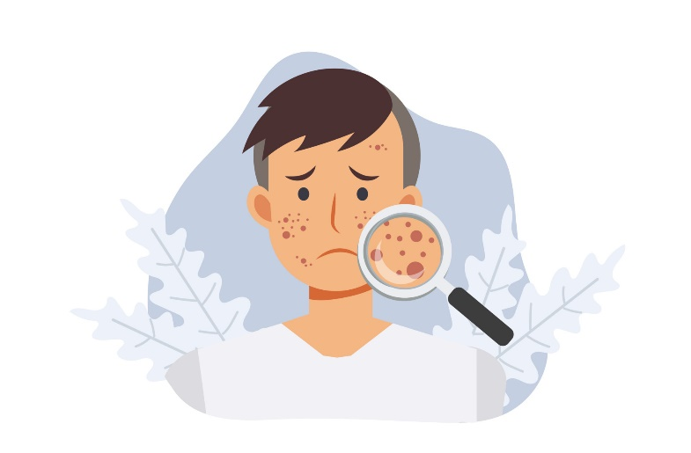
5
Research Objectives
4
Develop a Comprehensive Suite of Machine Learning and AI-Based Models for Acne Assessment and Management.
3
2
1
Project ID: 24-25J-210

Slide 12

Research Objectives
5
4
Develop an Advanced System for Accurate Detection and Severity Assessment of Eczema Using Image Processing Techniques.
3
2
1
Project ID: 24-25J-210

Slide 13
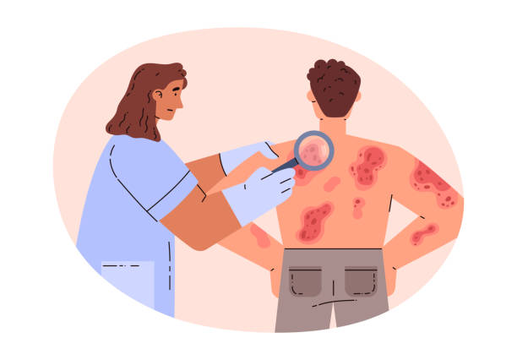
Research Objectives
5
Apply Machine Learning and Computer Vision to Detect Psoriasis and Assess Its Scaling Severity from Images.
4
3
2
1
Project ID: 24-25J-210

Slide 14

Component 1
Automated Advanced Acne Lesion
Analysis and Monitoring with Artificial Intelligence.
IT21176456 | Gimmana M.R.M
B.Sc (Hons) Degree in Information Technology Specializing in Data Science
IT21176456 | Gimmana M.R.M | 24-25J-210

Slide 15

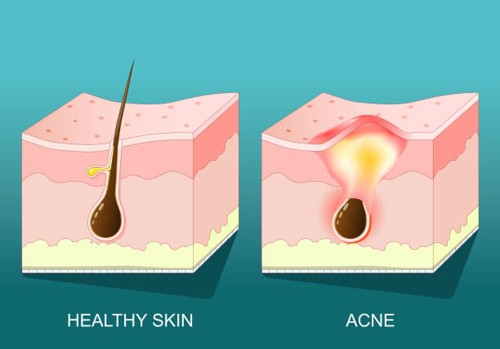
Background
What is Acne ?
Why we need an AI based Acne detection and monitoring system ?
What is the importance ?
IT21176456 | Gimmana M.R.M | 24-25J-210

Slide 16
What is Acne ?
Acne is a common chronic disorder affecting the hair follicle and
sebaceous gland, in which there is expansion and blockage
of the follicle and inflammation.
Who gets Acne?
Acne affects males and females of all races and ethnicities.
It is prevalent in adolescents and young adults,
with 85% of 16- to 18-year-olds affected.
However, it may sometimes occur in children and adults of all ages.
IT21176456 | Gimmana M.R.M | 24-25J-210

Slide 17
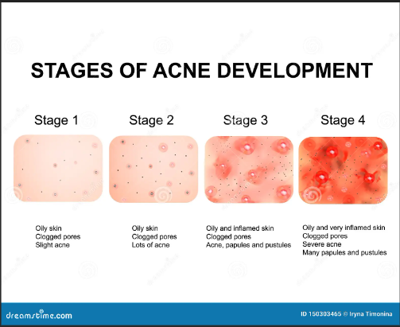
Acne Stages
IT21176456 | Gimmana M.R.M | 24-25J-210

Slide 18

Why we need an AI based Acne detection and monitoring system ?
Detect Acne in early stages.
Correct diagnosis of the current stage of the acne lesion.
Avoid Improper treatments.
Patients can track their healing progress.
Doctors can monitor the patient's healing progress between visits.

Slide 19

What is the importance ?
Early Detection and Diagnosis.
Personalized Healing Progress Monitoring.
Improved Accessibility and Convenience.
Remote Monitoring and Follow-up.
Data-Driven Insights.
IT21176456 | Gimmana M.R.M | 24-25J-210

Slide 20
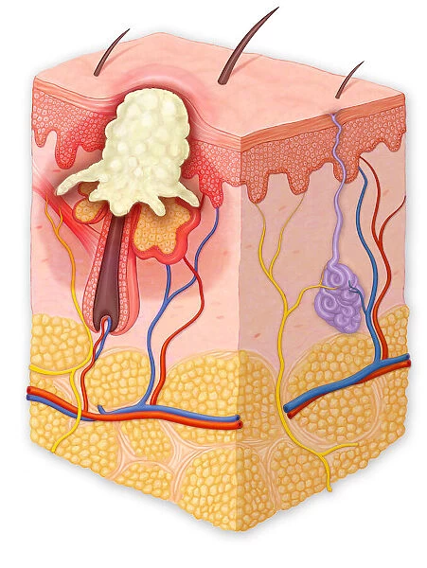
Research problem
How can we develop advanced machine learning techniques be leveraged through image analysis to enhance the precision of acne diagnosis and monitor treatment efficacy?
IT21176456 | GIMMANA M.R.M | 24-25J-210

Slide 21
Develop a Robust Detection Model
Standardize Severity Assessment
Incorporate Advanced Techniques
Track Acne Lesion healing Progress
Ensure Practical Applicability
Specific Sub Objectives
IT21176456 | Gimmana M.R.M | 24-25J-210

Slide 22



Research Gap
[1] Acne Detection Care System using Deep Learning
[2] Dermato: A Deep Learning based Application for Acne Subtype and Severity Detection
[3] Localization of Acne Lesion through Template Matching
[4] Acne Classification using Deep Learning Models
[5] Revolutionizing Acne Diagnosis with Hybrid Deep Learning Model integrating CBAM and Capsule Network
 | [1] | [2] | [3] | [4] | [5] | Proposed Solution
Diverse Datasets
Advance Severity Detection
Acne Lesion Segmentation and Spatial Analysis
Healing Progress Tracking
Research
Papers
Features
IT21176456 | Gimmana M.R.M | 24-25J-210

Slide 23
Novelty
Training the System
Siamese Neural Network Architecture
Image Processing for Lesion Analysis
Data Collection and Preprocessing
Combining Siamese Neural Networks with Image Processing to Acne Severity Level Detection.
IT21176456 | Gimmana M.R.M | 24-25J-210

Slide 24
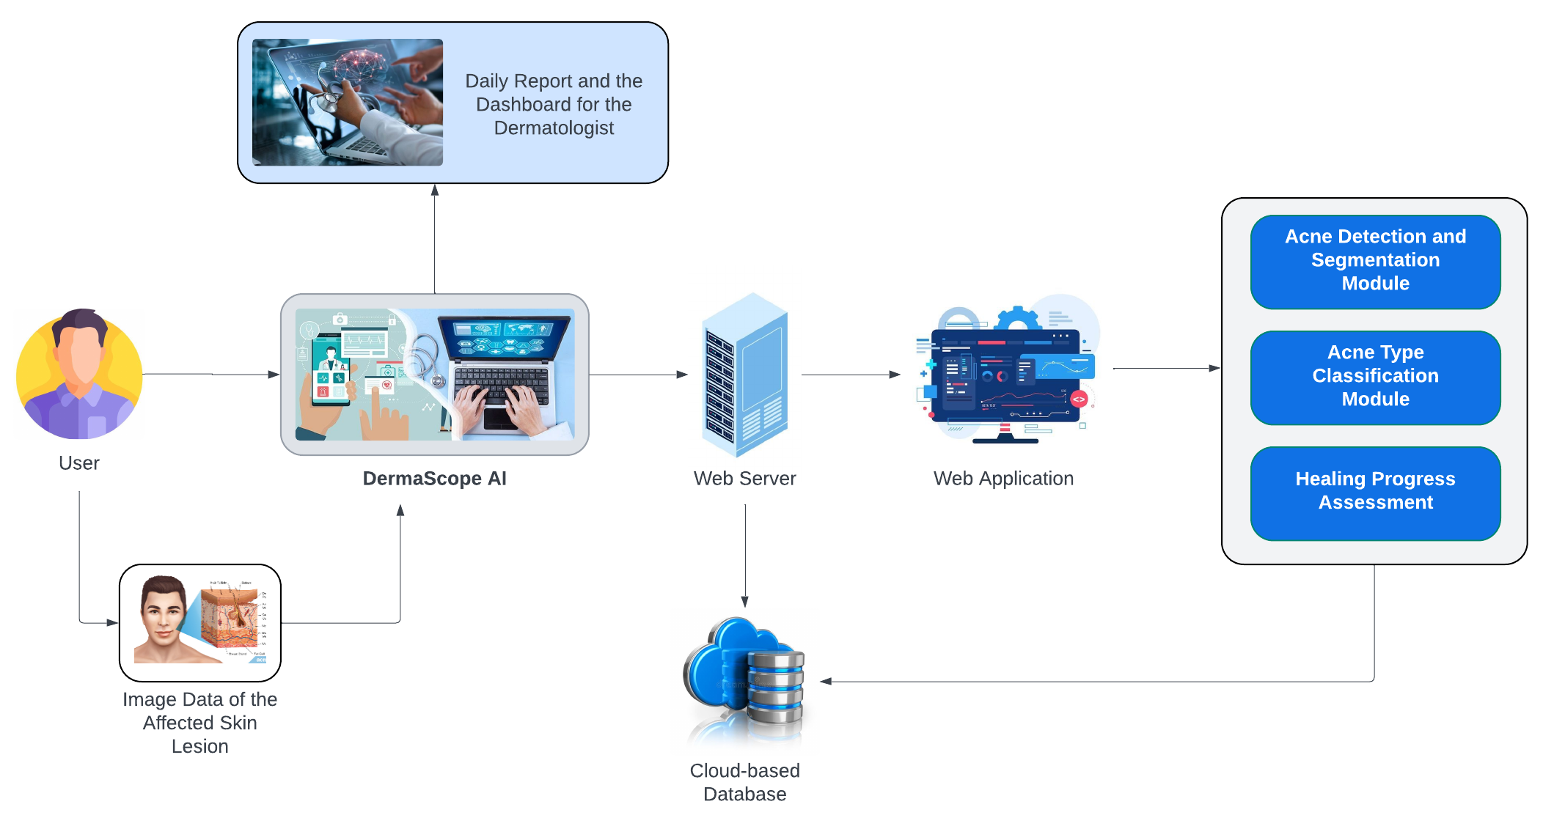
System Diagram
IT21176456 | Gimmana M.R.M | 24-25J-210

Slide 25
Requirements
Personal Requirements
Guidance from the Supervisors on the Eczema and Data Science domain.
Understand the Specific Area of Each Domain to Proceed with the Selected Research Area.
Functional Requirements
Acne Detection Module.
Severity Assessment Module.
Dynamic Segmentation Adjustment.
Non-Functional Requirements
Performance.
Scalability.
Usability.
Security and Privacy.
Reliability.
IT21176456 | Gimmana M.R.M | 24-25J-210

Slide 26
Reference
[1] Rohit Yadav , Aashika jain , Sanjiv Sharma . “Acne Detection Care System using Deep Learning”. 2024 11th International Conference on Reliability, Infocom Technologies and Optimization (Trends and Future Directions) (ICRITO) | 979-8-3503-5035-7/24/$31.00 ©2024 IEEE | DOI: 10.1109/ICRITO61523.2024.1052241
[2] Krithika Naidu , omkar Kareppa , Sridha Menon , Chitra Bhole , Dr.Shital Poojary . “Dermato: A Deep Learning based Application for Acne Subtype and Severity Detection”. International Conference on Innovative Data Communication Technologies and Application (ICIDCA-2023) IEEE Xplore Part Number: CFP23CR5-ART; ISBN: 979-8-3503-9720-8
[3] Jawad Humayun , Aamir Saeed Malik , Samir Brahim Belhaouari , Nidal Kamel . “Localization of Acne Lesion through Template Matching”. Electrical and Electronic Engineering Department University Technology PETRONAS. 2012 4th International Conference on Intelligent and Advanced Systems (ICIAS2012).
[4] Kusum Meda Ravi , Krian M K , Umadevi V . “Acne Classification using Deep Learning Models “ . 2024 1st International Conference on Communications and Computer Science (InCCCS) | 979-8-3503-5885-8/24/$31.00 ©2024 IEEE | DOI: 10.1109/INCCCS60947.2024.10593603
[5] Paluri Krishna Veni , Ashish Gepta . “Revolutionizing Acne Diagnosis with Hybrid Deep Learning Model integrating CBAM and Capsule Network “. Received 4 May 2024, accepted 6 June 2024, date of publication 11 June 2024, date of current version 19 June 2024.
IT21176456 | Gimmana M.R.M | 24-25J-210

Slide 27

Component 2
Utilizing Advanced Machine Learning Technologies For Detailed Eczema Diagnosis And Assessment
IT21262104 | Lakshani D.M.W.S
B.Sc (Hons) Degree in Information Technology Specializing in Data Science
IT21262104 | Lakshani D.M.W.S | 24-25J-210

Slide 28
Background
What is Eczema?
What are the current challenges and need for an advanced solution?
How Advanced Machine Learning Techniques Can Improve the Assessment of Eczema Lesions?
IT21262104 | Lakshani D.M.W.S | 24-25J-210

Slide 29
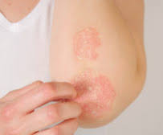
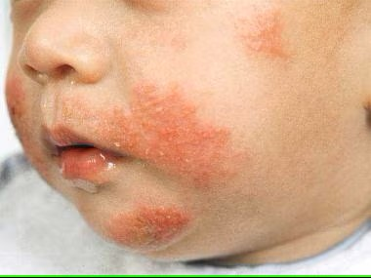
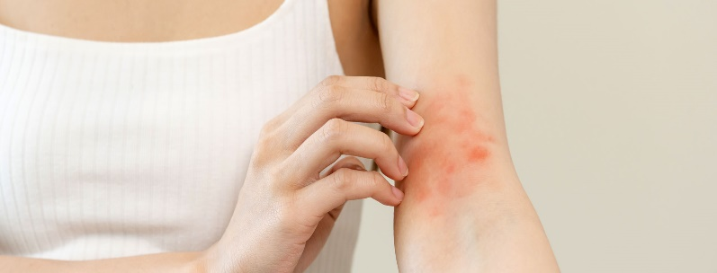
What is Eczema?
A common skin condition.
Skin becomes dry, itchy and easily irritated.
Affects individuals of all ages and can significantly impact quality of life.
Possible to spread to different areas of the body.
Eczema can be caused by,
Dry climate
Foods
Cosmetics
Soaps
Wool
Dust mites
Mold
Pets
Pollen
IT21262104 | Lakshani D.M.W.S | 24-25J-210

Slide 30

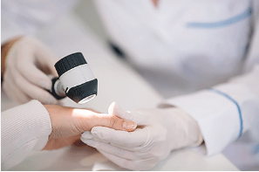
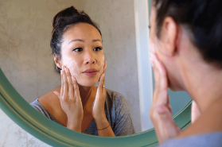
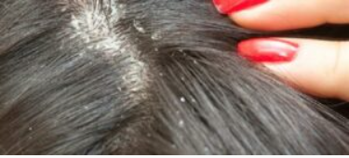
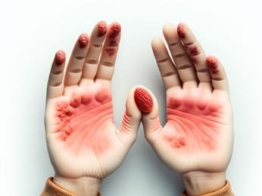
Multiple Types of Eczema
Atopic Dermatitis
Often begins in childhood.
A common type of Eczema.
Nummular Eczema
Appears as coin-shaped spots on the skin that can be painful and difficult to treat.
Contact Dermatitis
Called allergic contact dermatitis. Causes an allergic skin reaction.
Seborrheic Dermatitis
Usually affects the scalp.
Rarely causes severe harm to the body.
Dyshidrotic Eczema
Tiny blisters on your hands, feet, or both.
IT21262104 | Lakshani D.M.W.S | 24-25J-210

Slide 31
Current Challenges
Diagnosis
Relies heavily on visual inspection by dermatologists, which can be subjective and inconsistent.
Early Detection
Failure to detect early signs can lead to progression and complications, increasing patient discomfort and healthcare costs.
IT21262104 | Lakshani D.M.W.S | 24-25J-210

Slide 32

Research Problem
How can advanced machine learning technologies be effectively utilized to improve the accuracy, efficiency, and consistency of eczema diagnosis and severity assessment from images?
IT21262104 | Lakshani D.M.W.S | 24-25J-210

Slide 33
Utilizing Advanced ML Technologies for Detailed Eczema Diagnosis and Assessment
Develop a Robust Detection Model
Standardize Severity Assessment Based on Erythema
Incorporate Advanced Techniques
Ensure Practical Applicability
Specific Sub Objectives
IT21262104 | Lakshani D.M.W.S | 24-25J-210

Slide 34
Research Gap
[1] Automatic Segmentation and Classification of Eczema Skin Lesions Using Supervised Learning
[2] Detection of Common Types of Eczema Using Gray Level Co-occurrence Matrix and Support Vector Machine
[3] Reliable Detection of Eczema Areas for Fully Automated Assessment of Eczema Severity from Digital Camera Images
[4] EczemaNet: A Deep CNN-based Eczema Diseases Classification
[5] Segmentation of Eczema Skin Lesions Using U-Net
Research
Papers
 | [1] | [2] | [3] | [4] | [5] | Proposed Solution
Incorporate Advanced Deep Learning Techniques
Enhance Explainability
Improve Robustness
Addressing Severity Levels of Eczema
Develop Adaptive Multi-Scale Attention Mechanism
Features
IT21262104 | Lakshani D.M.W.S | 24-25J-210

Slide 35

Novelty
Adaptive Multi-Scale Attention Network for Explainable and Robust Eczema Type and Severity Classification
Enhanced Robustness Through Advanced Augmentation
Comprehensive Eczema Diagnosis and Management
Explainable AI with Attention Maps
Eczema Lesion Severity Assessment
Adaptive Multi-Scale Feature Extraction
IT21262104 | Lakshani D.M.W.S | 24-25J-210

Slide 36
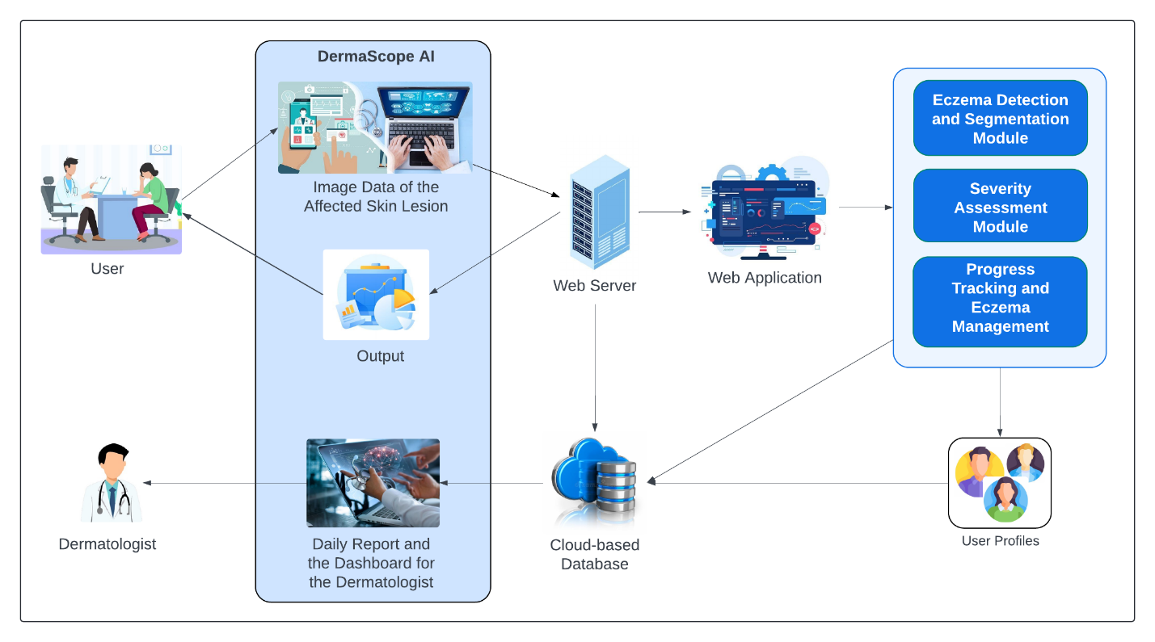
System Diagram
IT21262104 | Lakshani D.M.W.S | 24-25J-210

Slide 37
Requirements
Personal Requirements
Guidance from the Supervisors on the Eczema and Data Science domain.
Understand the Specific Area of Each Domain to Proceed with the Selected Research Area.
Functional Requirements
Eczema Detection Module.
Severity Assessment Module.
Dynamic Segmentation Adjustment.
Adaptive Multi-Scale Attention Mechanism.
Non-Functional Requirements
Performance
Scalability
Usability
Security and Privacy
Reliability
IT21262104 | Lakshani D.M.W.S | 24-25J-210

Slide 38
References
[1] Nisar, K., Zubair, M., & Rauf, H. T. (2020). "Automatic Segmentation and Classification of Eczema Skin Lesions Using Supervised Learning," 2020 IEEE Conference on Open Systems (ICOS), pp. 53-58. DOI: 10.1109/ICOS48179.2021.9398739.
[2] I. B. I. Raja, S. H. Abid, A. B. M. H. Rashid, & A. R. Arif. (2019). "Detection of Common Types of Eczema Using Gray Level Co-occurrence Matrix and Support Vector Machine," 2019 International Conference on Advanced Computing and Communication Systems (ICACCS), pp. 1-5. DOI: 10.1109/ICACCS.2019.8728514.
[3] M. Y. Cheong, & Y. A. Hamed. (2020). "Reliable Detection of Eczema Areas for Fully Automated Assessment of Eczema Severity from Digital Camera Images," 2020 IEEE EMBS Conference on Biomedical Engineering and Sciences (IECBES), pp. 362-366. DOI: 10.1109/IECBES48179.2021.9398739.
[4] Zhang, Y., Li, H., Wang, X., & Yang, J. (2021). "EczemaNet: A Deep CNN-based Eczema Diseases Classification," 2021 IEEE 15th International Conference on Anti-counterfeiting, Security, and Identification (ASID), pp. 45-49. DOI: 10.1109/ASID53146.2021.9618825.
[5] R. T. Tong, S. H. Lee, & P. H. Lee. (2020). "Segmentation of Eczema Skin Lesions Using U-Net," 2020 IEEE EMBS Conference on Biomedical Engineering and Sciences (IECBES), pp. 359-361. DOI: 10.1109/IECBES48179.2021.9398739.
IT21262104 | Lakshani D.M.W.S | 24-25J-210

Slide 39
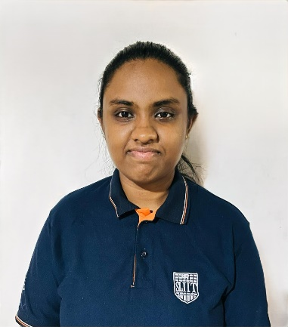
Component 3
Automated AI-augmented Approach To Psoriasis Lesion Detection And Accurate Scaling Severity Evaluation
IT21261732 | Perera W.A.S.K
B.Sc (Hons) Degree in Information Technology Specializing in Data Science
IT21261732 | Perera W.A.S.K | 24-25J-210

Slide 40

Background
What is psoriasis and what is scaling?
Why is accurate detection and segmentation of psoriasis lesions important?
How can advanced machine learning techniques improve the precision and reliability of psoriasis assessment?
IT21261732 | Perera W.A.S.K | 24-25J-210

Slide 41
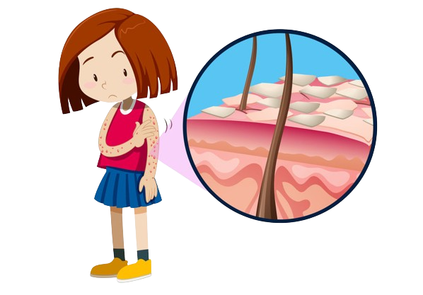
What is psoriasis and what is scaling?
Nature of Psoriasis
What is Scaling
Buildup of excess skin
cells
Chronic skin disease
Appears as thick,
silvery patches on the
skin
Rapid growth of skin
cells
Leads to the buildup of scales and inflammation
Indicates the severity
IT21261732 | Perera W.A.S.K | 24-25J-210

Slide 42
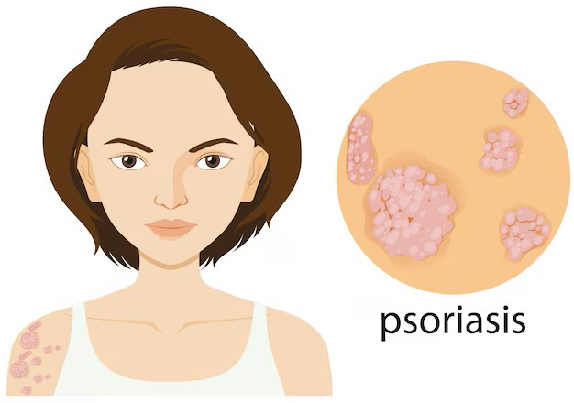
---
Why is accurate detection and segmentation of psoriasis lesions important?
Ensures Timely Treatment
Improves Patient Outcomes
Reduces the psychological and
physical burden on patients
IT21261732 | Perera W.A.S.K | 24-25J-210

Slide 43

---
---
How can advanced machine learning techniques improve the precision and reliability of psoriasis assessment?
Enhanced Precision
Consistent and unbiased analysis
Enables real-time assessment
and monitoring
IT21261732 | Perera W.A.S.K | 24-25J-210
IT21261732 | Perera W.A.S.K | 24-25J-210

Slide 44
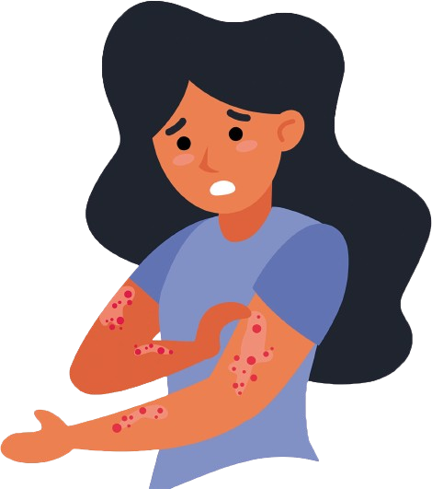
Automated Ai-augmented Approach To Psoriasis Lesion Detection And Accurate Scaling Severity Evaluation
Research Problem
In what ways can cutting-edge machine learning methodologies be leveraged to significantly improve the precision, efficiency, and reliability of psoriasis detection, segmentation, feature extraction, and scaling severity assessment from digital images?
IT21261732 | Perera W.A.S.K | 24-25J-210

Slide 45
Automated AI-augmented Approach To Psoriasis Lesion Detection And Accurate Scaling Severity Evaluation
Specific Sub Objectives
Develop Advanced Detection and Segmentation Model
Detailed Feature Extraction from Psoriasis Lesions
Comprehensive Psoriasis Scaling Severity Classification
Enhanced Scaling Severity Measurement System
Monitoring Psoriasis Scaling Severity
IT21261732 | Perera W.A.S.K | 24-25J-210

Slide 46
Research Gap
[1] A Novel Approach for Automatic Identification of Psoriasis Affected Skin Area.
[2] Automatic Scale Severity Assessment Method in Psoriasis Skin Images Using Local Descriptors
[3] Comparison of Psoriasis Disease
Detection and Classification Through Various Image Processing Techniques-A Review
[4] Psoriasis Detection Based on Deep Neural Network
[5] Evaluation of psoriasis skin disease classification using convolutional neural network
Research
Papers
 | [1] | [2] | [3] | [4] | [5] | Proposed Solution
Implement Cutting-Edge Deep Learning Models
Integrate Explainable AI Methods
Improve Robustness
Develop Multi-Scale Superpixel Clustering Techniques
Analyze the Distribution and Clustering of Scales
Features
IT21261732 | Perera W.A.S.K | 24-25J-210

Slide 47
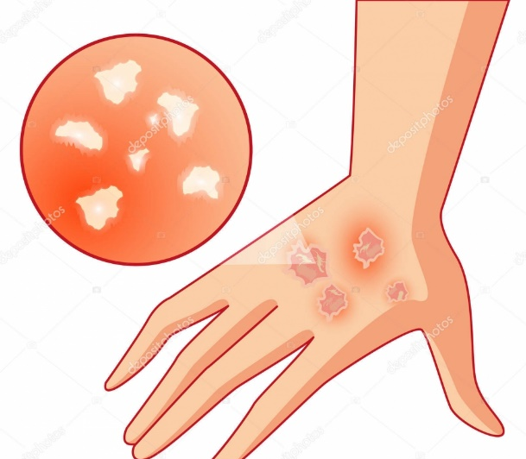
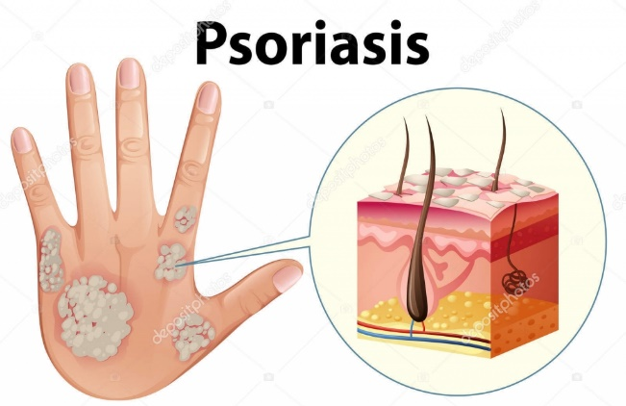
Novelty
Scale Pattern Analysis and Determining Severity Levels
(distribution and clustering of scales)
Segment the Scales from the Images
Analyze the Distribution, and Clustering of Scales
Develop Metrics for Uniformity and Dispersion
Correlate Metrics with Severity Levels
IT21261732 | Perera W.A.S.K | 24-25J-210

Slide 48

System Diagram
IT21261732 | Perera W.A.S.K | 24-25J-210

Slide 49
Requirements
Personal Requirements
Guidance from the Supervisors on the Psoriasis and Data Science domain.
Gain a deep understanding of the specific areas within the Psoriasis and data science fields to proceed with the research effectively.
Functional Requirements
Psoriasis Detection and Segmentation Module
Feature Extraction Module
Psoriasis Scaling Severity Classification Module
Enhanced Scaling Severity Measurement Module
Non-Functional Requirements
Performance
Scalability
Usability
Security and Privacy
Reliability
IT21261732 | Perera W.A.S.K | 24-25J-210

Slide 50
References
References
[1] T. R. Arunkumar and H. S. Jayanna, "A Novel Approach For Automatic Identification Of Psoriasis Affected Skin Area," 2017 2nd International Conference On Emerging Computation and Information Technologies (ICECIT), Tumakuru, India, 2017, pp. 1-8, doi: 10.1109/ICECIT.2017.8453316.
[2] Y. George, M. Aldeen and R. Garnavi, "Automatic Scale Severity Assessment Method in Psoriasis Skin Images Using Local Descriptors," in IEEE Journal of Biomedical and Health Informatics, vol. 24, no. 2, pp. 577-585, Feb. 2020, doi: 10.1109/JBHI.2019.2910883
[3] L. Vincent and J. Roopa Jayasingh, "Comparison of Psoriasis Disease Detection and Classification Through Various Image Processing Techniques-A Review," 2022 6th International Conference on Devices, Circuits and Systems (ICDCS), Coimbatore, India, 2022, pp. 122-124, doi: 10.1109/ICDCS54290.2022.9780692.
[4] J. -M. Syu, C. -H. Lai, G. -S. Lin and S. -K. Chai, "Psoriasis Detection Based on Deep Neural Network," 2018 IEEE International Conference on Consumer Electronics-Taiwan (ICCE-TW), Taichung, Taiwan, 2018, pp. 1-2, doi: 10.1109/ICCE-China.2018.8448609.
[5] A. H. R. S. S. G. Manoharan, S. G. Senanayake, and A. G. A. J. S. Ja," International Conference on Advanced Communication Technology (ICACT), yarathna, "Evaluation of psoriasis skin disease classification using convolutional neural networkpp. 355-359, Feb. 2020.
IT21261732 | Perera W.A.S.K | 24-25J-210

Slide 51





Technologies To Be Used
Development Environments
Jupyter Notebooks
Visual Studio Code
Database
Firebase
Web Frameworks
Flask
Django
Version Control and Collaboration Tools
GitHub
Deep Learning Frameworks
TensorFlow
Mask R-CNN
Machine Learning Libraries
scikit-learn
AutoKeras
Programming Languages
Python
Data Augmentation and Preprocessing Tools
OpenCV
Pandas
Matplotlib
Project ID: 24-25J-210

Slide 52
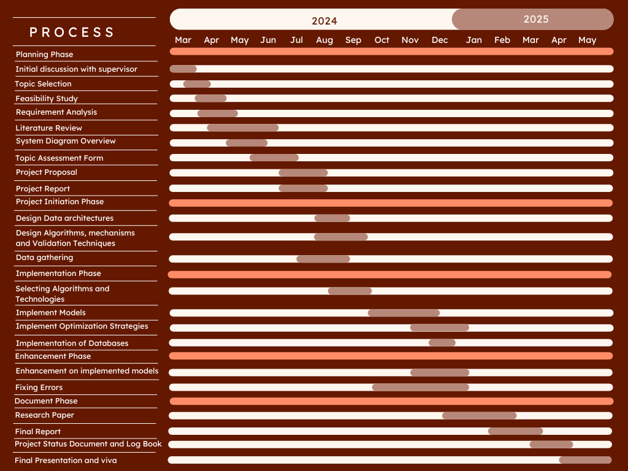
Gannt Chart
Project ID: 24-25J-210

Slide 53
Work Break Down Structure
Utilizing Advanced ML Technologies For Detailed Eczema Diagnosis And Assessment
Initiation
Planning
Design
Implementation
Enhancement
Close Out
Define project objectives
Requirement analysis
Design system architecture
Collect and preprocess data
Optimize model performance
Conduct final project review
Identify stakeholders
Develop project plan
Select and design models
Develop and train models
Implement advanced features
Prepare final report
Prepare project charter
Conduct feasibility study
Plan data preprocessing
Integrate models into system
Enhance explainability
Publish research papers
Prepare project proposal
Define timeline and milestones
Design database schema
Conduct testing and validation
Future recommendations
Define integration strategy
IT21262104 | Lakshani D.M.W.S | 24-25J-210

Slide 54
Contribution to the Domain / Commercialization
Enhanced Diagnostic Precision and Consistency
Automated Image Analysis for Efficient Workflow
Enhanced Patient Monitoring and Progress Tracking
Standardized Severity Assessment Tools
Enhanced Explainability and Trust in AI-driven Solution
Software improvements which are helping to overcome device-related improvements.
Project ID: 24-25J-210

Slide 55

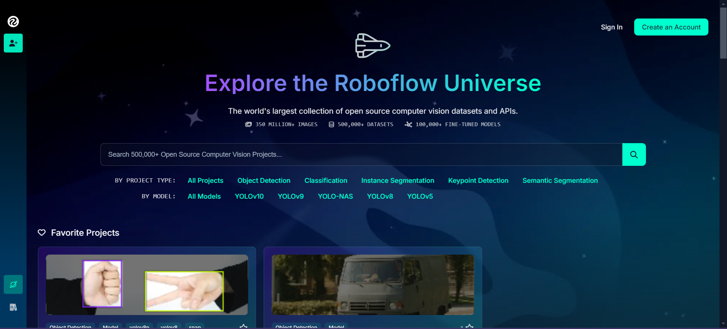
DermNet : Information / Data collection
Roboflow : Information
Project ID: 24-25J-210

Slide 56
THANK YOU
Project ID: 24-25J-210

